Slide 1
RISK MATRIX
RISK MATRIX IN POWER BI

Slide 2
RISK MATRIX
01
A risk matrix is a tool used during the risk assessment stage of project planning. It identifies and captures the likelihood of project risks and evaluates the potential damage or interruption caused by those risks.
Notes:
Template from: https://www.freeppt7.com/

Slide 3
Objectives of Risk Matrix
Staying Updated with Evolving Risks
RISK IDENTIFICATION.
04
01
03
02
Targeted Strategy for Managing Risks
HELPS IN DECISION MAKING

Slide 4
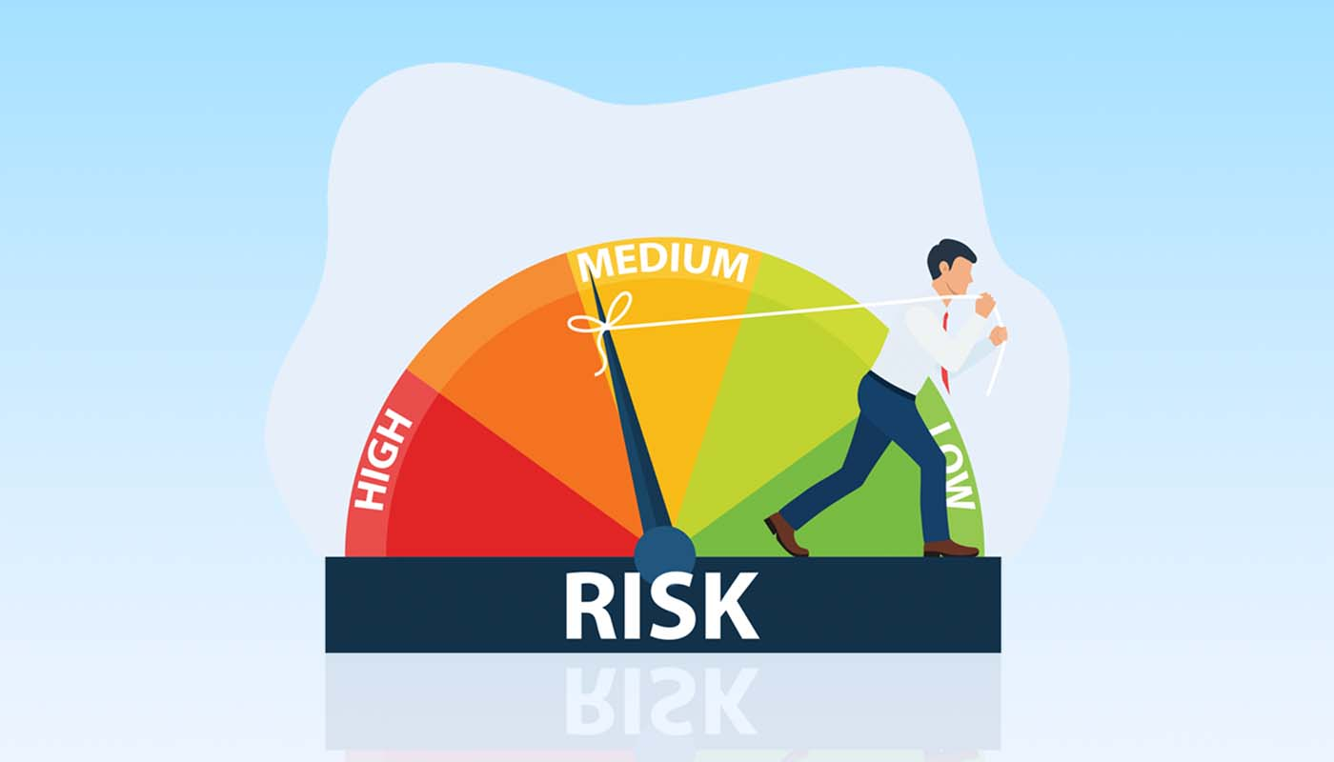
RISK MATRIX IN REAL WORLD
1
Supply Chain Management
3
Strategic Planning
2
Project Management
4
Financial Risk Assessment

Slide 5

Source Of Data
From git hub link of a project
From you tube project
From myself
Data Description
The dataset is sourced from a sample risk data consisting of four major categories-Finance, Infrastructure, Safety & Security along with their Risk IDs.
This dataset comprises of likelihood and severity values:
Likelihood values
1 Rare : A very slim chance for this risk to occur.
2 Unlikely : Low chances for this risk to occur.
3 Possible : Fifty-fifty chances for this risk to occur.
4 Likely : Good chances for this risk to occur.
5 Almost Certain : You can bet this risk will occur at some point.
Severity values
1 Negligible : The risk will have little consequences if occurs.
2 Minor : The consequences of the risk will be easy to manage.
3 Moderate : The consequences of the risk will take time to mitigate.
4 Major : The consequences of this risk will be significant and may cause long-term damage.
5 Catastrophic : The consequences of this risk will be detrimental and may be hard to recover from.

Slide 6




CREATING RISK MATRIX IN POWER BI
Import Your
Risk Data
Create a
Bridge Table
Create Relationships
Create the Risk Matrix Visual

Slide 7
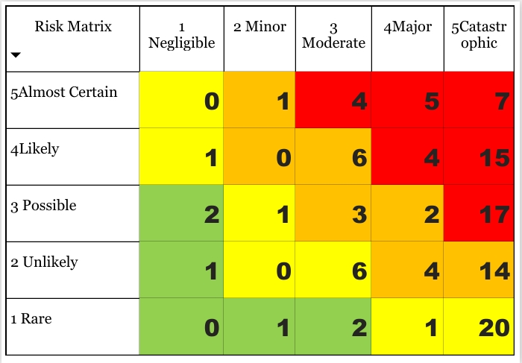
RISK MATRIX
Extreme
High
Moderate
Low

Slide 8
Y-axis
1 Rare : A very slim chance for this risk to occur.
2 Unlikely : Low chances for this risk to occur.
3 Possible: Fifty-fifty chances for this risk to occur.
4 Likely : Good chances for this risk to occur.
5 Almost Certain : You can bet this risk will occur at some point.
X-axis
1 Negligible : The risk will have little consequences if it occurs.
2 Minor : The consequences of the risk will be easy to manage.
3 Moderate : The consequences of the risk will take time to mitigate.
4 Major : The consequences of this risk will be significant and may cause long-term damage.
5 Catastrophic : The consequences of this risk will be detrimental and may be hard to recover from.

Slide 9
PPT下载 http://www.freeppt7.com/xiazai/
RISK MATRIX
01
Create Necessary Table
NOTES
02
Write Correct Code
03
Add Some Other Visuals
With Matrix

Slide 10


References
Power BI Tutorial: Create An Advanced Risk Matrix Visual – P2 [ YouTube Channel: NextGen BI Guru ]
WWW.auditboard.com
www.safetyculture.com

Slide 11
THANK YOU

